Slide 1





JAI SHREE GANESH
WELCOME TO WORLD OF ANALYTICS

Slide 2
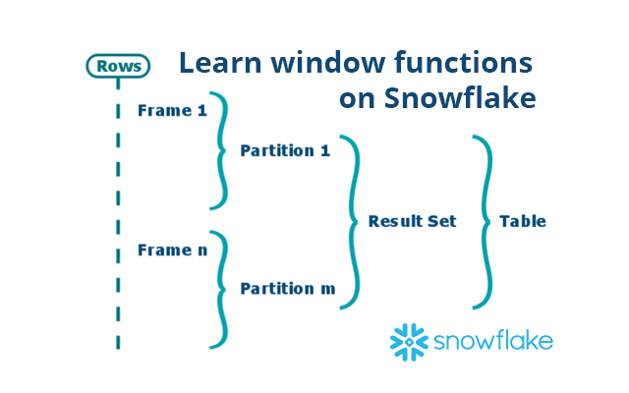
Window Functions
Window functions in Snowflake are a way to compute values over a group of rows.
They return a single value for each row, in contrast to aggregate functions which return a single value for a group of rows.
Window functions are the base of data warehousing workloads for many reasons.
First of all they are very similar to the GROUP BY clause as they run on a set of rows instead of a single one but, but unlike the GROUP BY clause we do not lose the individual rows.
To remedy this we could perform a self join with the result of GROUP BY operation but window functions implement the same functionality in a more efficient way that gives better performance.
Window functions also provide complex functions that are based on the (requested) order of rows such as DENSE_RANK which would be hard to implement with traditional SQL.
Using window functions you can avoid writing procedural SQL code.

Slide 3
OVERVIEW
What is a Window?
A window is a group of related rows.
For example, a window might be defined based on timestamps, with all rows in the same month grouped in the same window.
Or a window might be defined based on location, with all rows from a particular city grouped in the same window.
A window can consist of zero, one, or multiple rows.
For simplicity, Snowflake documentation usually says that a window contains multiple rows.

Slide 4
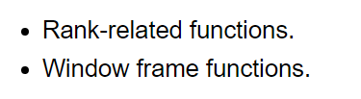
OVERVIEW
Some window functions are order-sensitive. There are two main types of order-sensitive window functions:
Rank-related functions list information based on the “rank” of a row.
For example, if you rank stores in descending order by profit per year, the store with the most profit will be ranked 1; the second-most profitable store will be ranked 2, etc.
Window frame functions allow you to perform rolling operations, such as calculating a running total or a moving average, on a subset of the rows in the window.

Slide 5
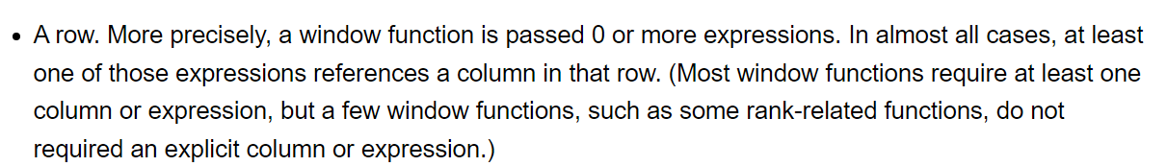
What is a Window Function?
A window function is any function that operates over a window of rows.
A window function is generally passed two parameters:

Slide 6
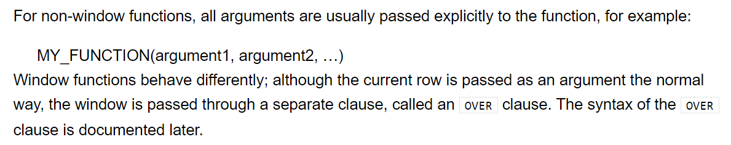
What is a Window Function?

Slide 7
Why use window functions?
Window functions are very powerful, and once you've gotten your head around how to use them, you'll be surprised at what they allow you to do.
Some common use cases are:
Running/Cumulative Total
Moving Average
Rank rows by custom criteria and groupings
Finding the year-over-year % Change

Slide 8

SYNTAX
where the PARTITION BY denotes how to GROUP rows into partitions, ORDER BY how to order the rows in those partitions, and FRAME which determines which rows to consider in those ordered partitions.
Each time a window function is called, it is passed a row (the current row in the window) and the window of rows that contain the current row.
The window function returns one output row for each input row.
The output depends on the individual row passed to the function and the values of the other rows in the window passed to the function.

Slide 9
TYPES
In general, window functions can be grouped into 3 types:
Navigation functions: Return the value given a specific location criteria (e.g. first_value)
Numbering functions: Assign a number (e.g. rank) to each row based on their position in the specified window
Analytic functions: Perform a calculation on a set of values (e.g. sum)

Slide 10
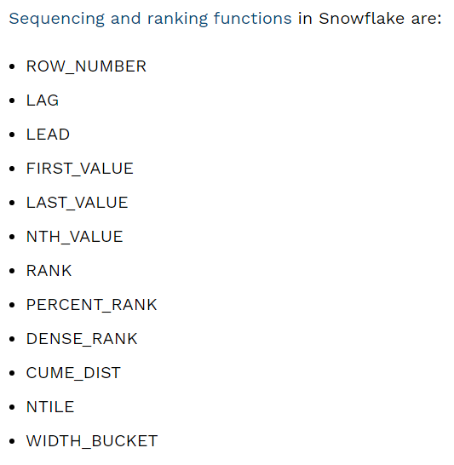
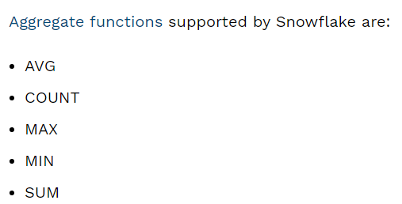
Aggregate and sequencing functions on Snowflake
Aggregate functions perform operations that take into account all values across a window. Sequencing functions produce output based on the position of the row in the window.

Slide 11
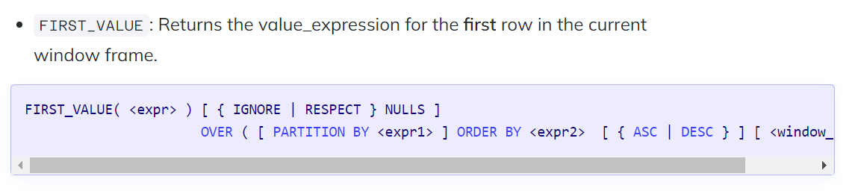
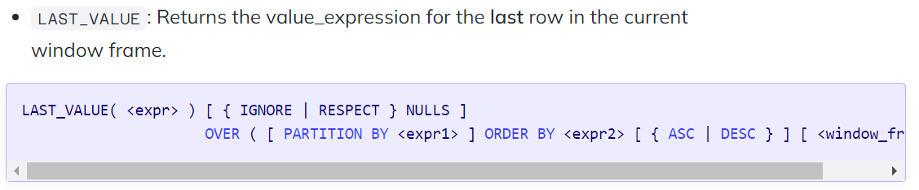
Navigation functions

Slide 12
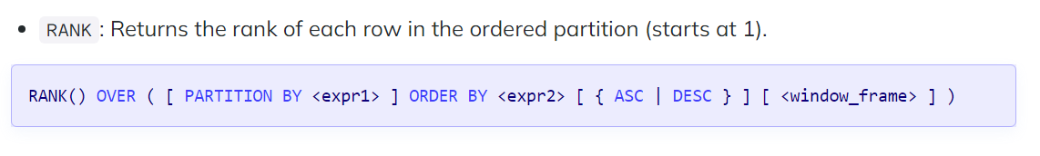
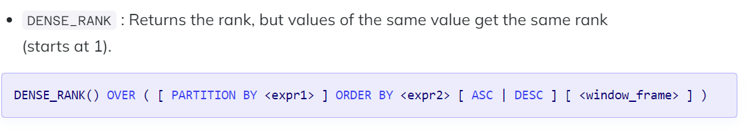
Numbering functions

Slide 13
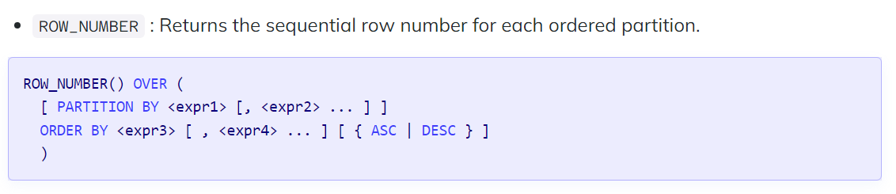
Numbering functions

Slide 14


